Slide 1
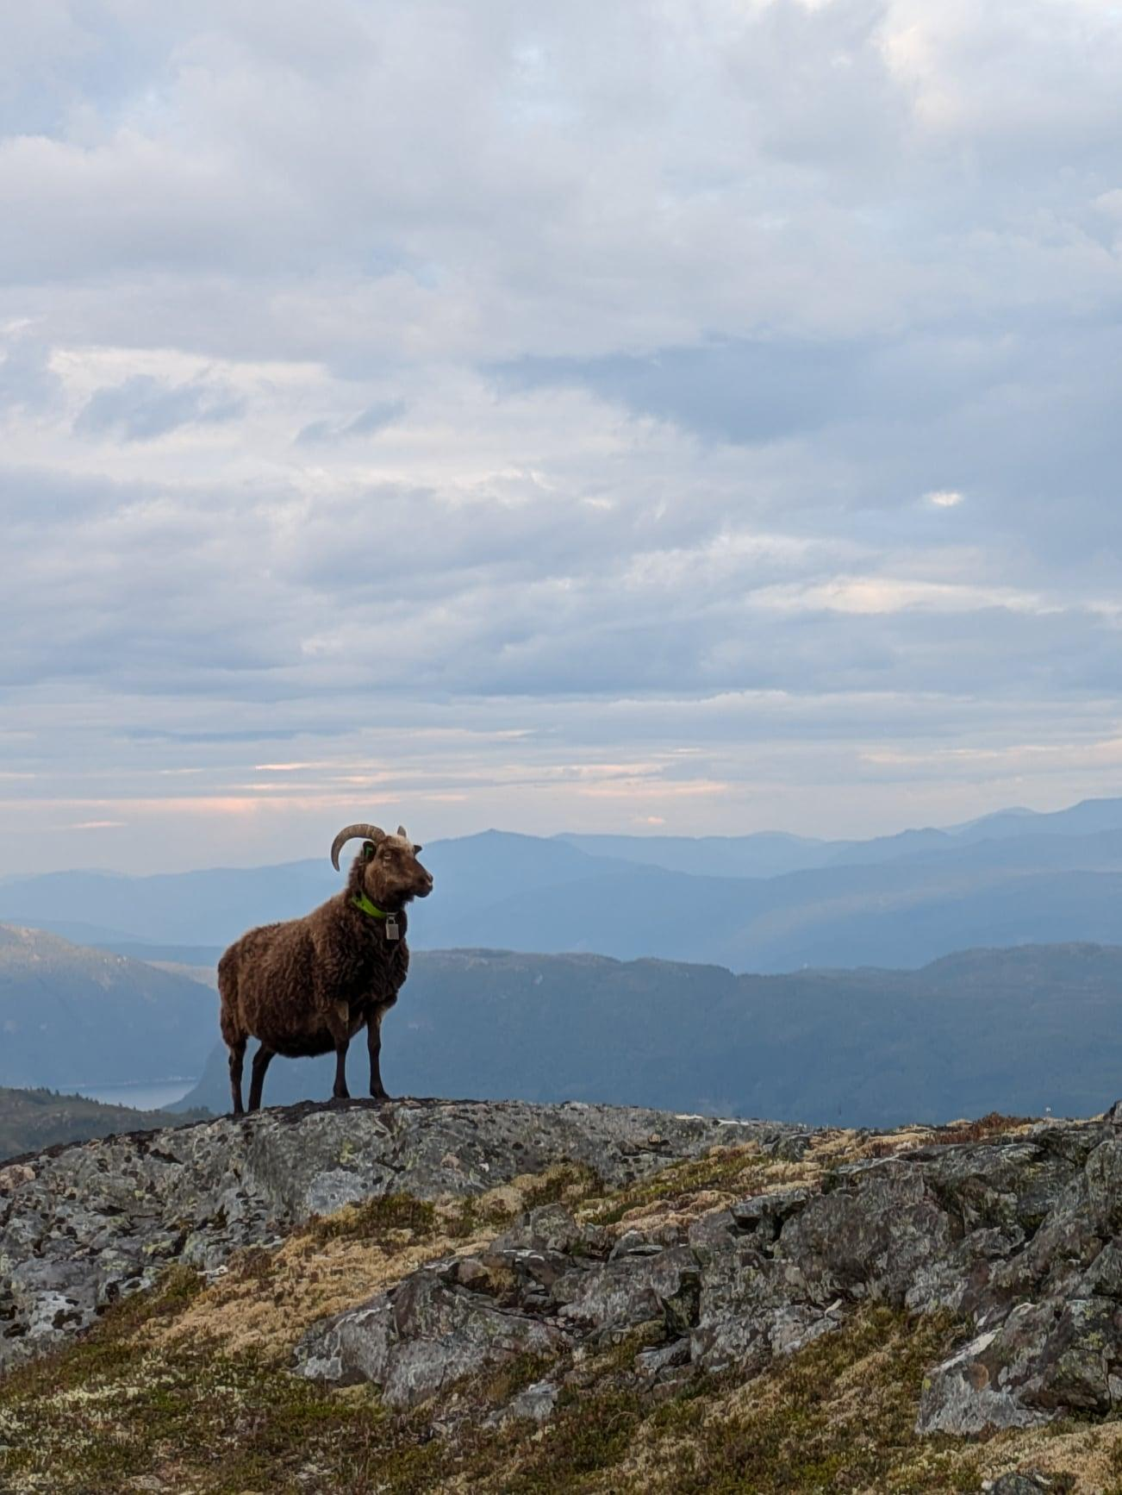
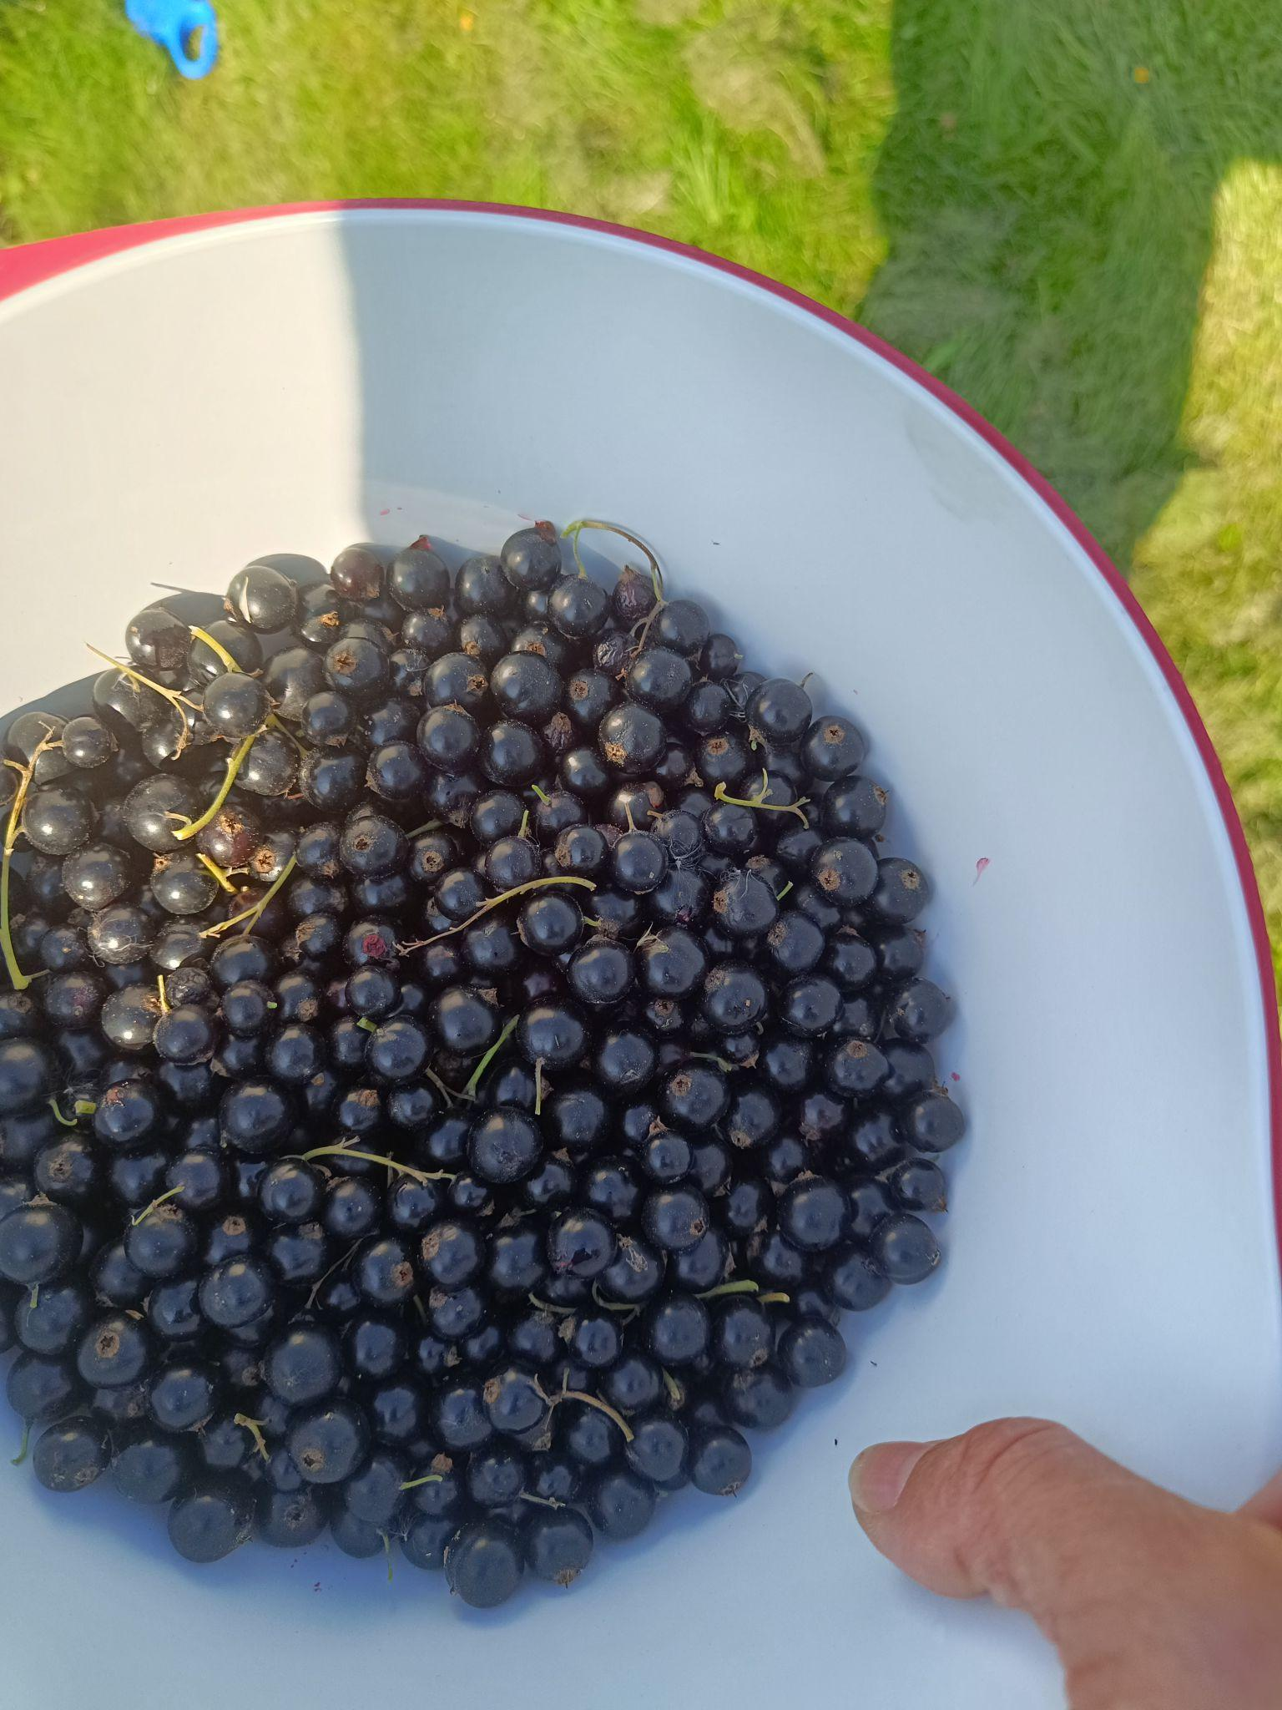
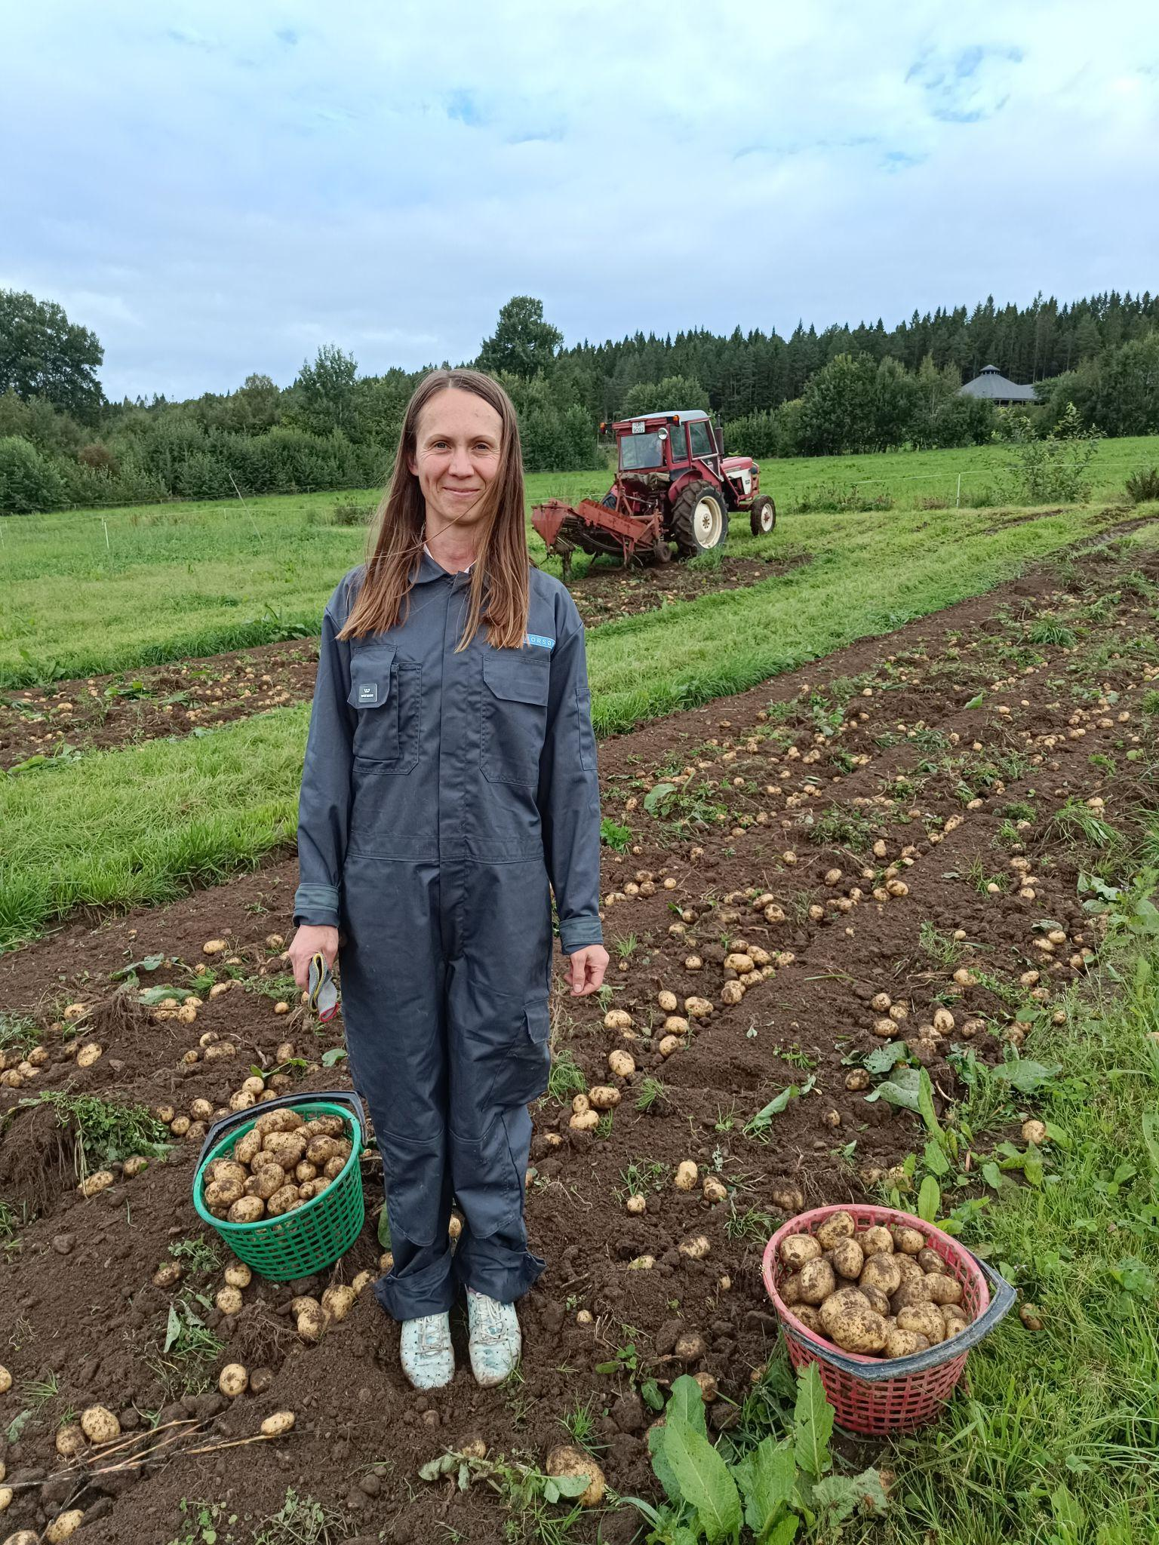
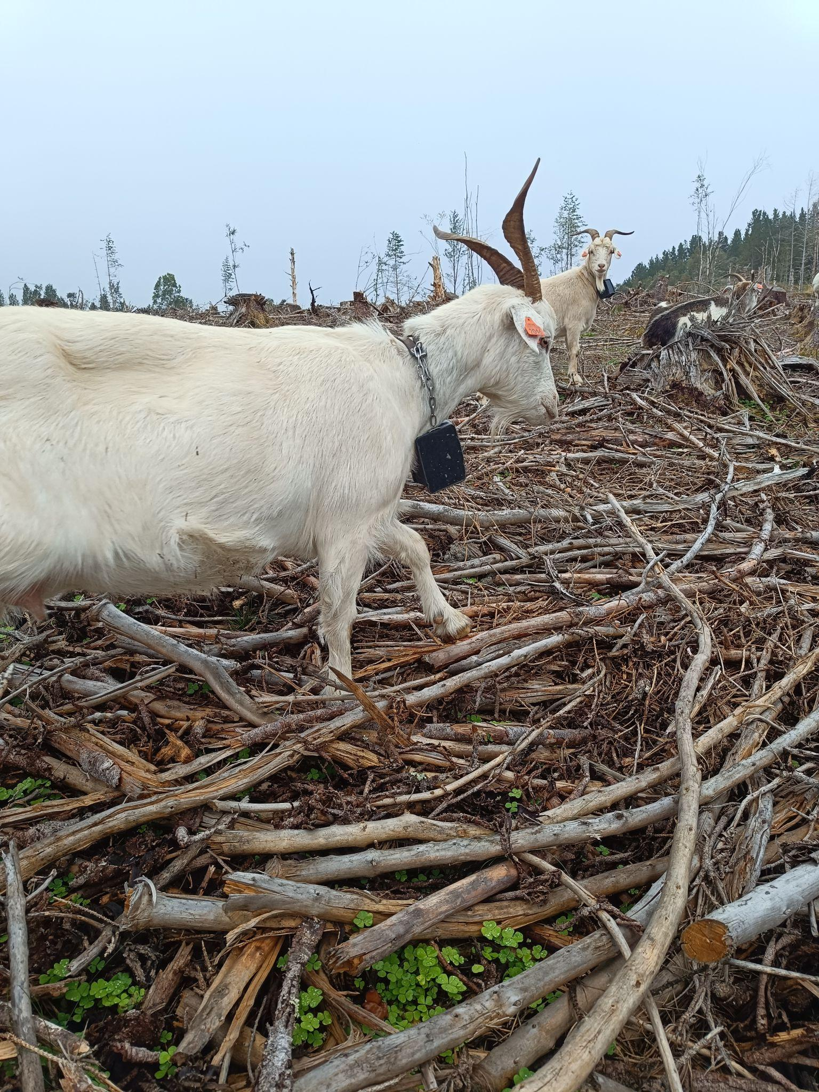
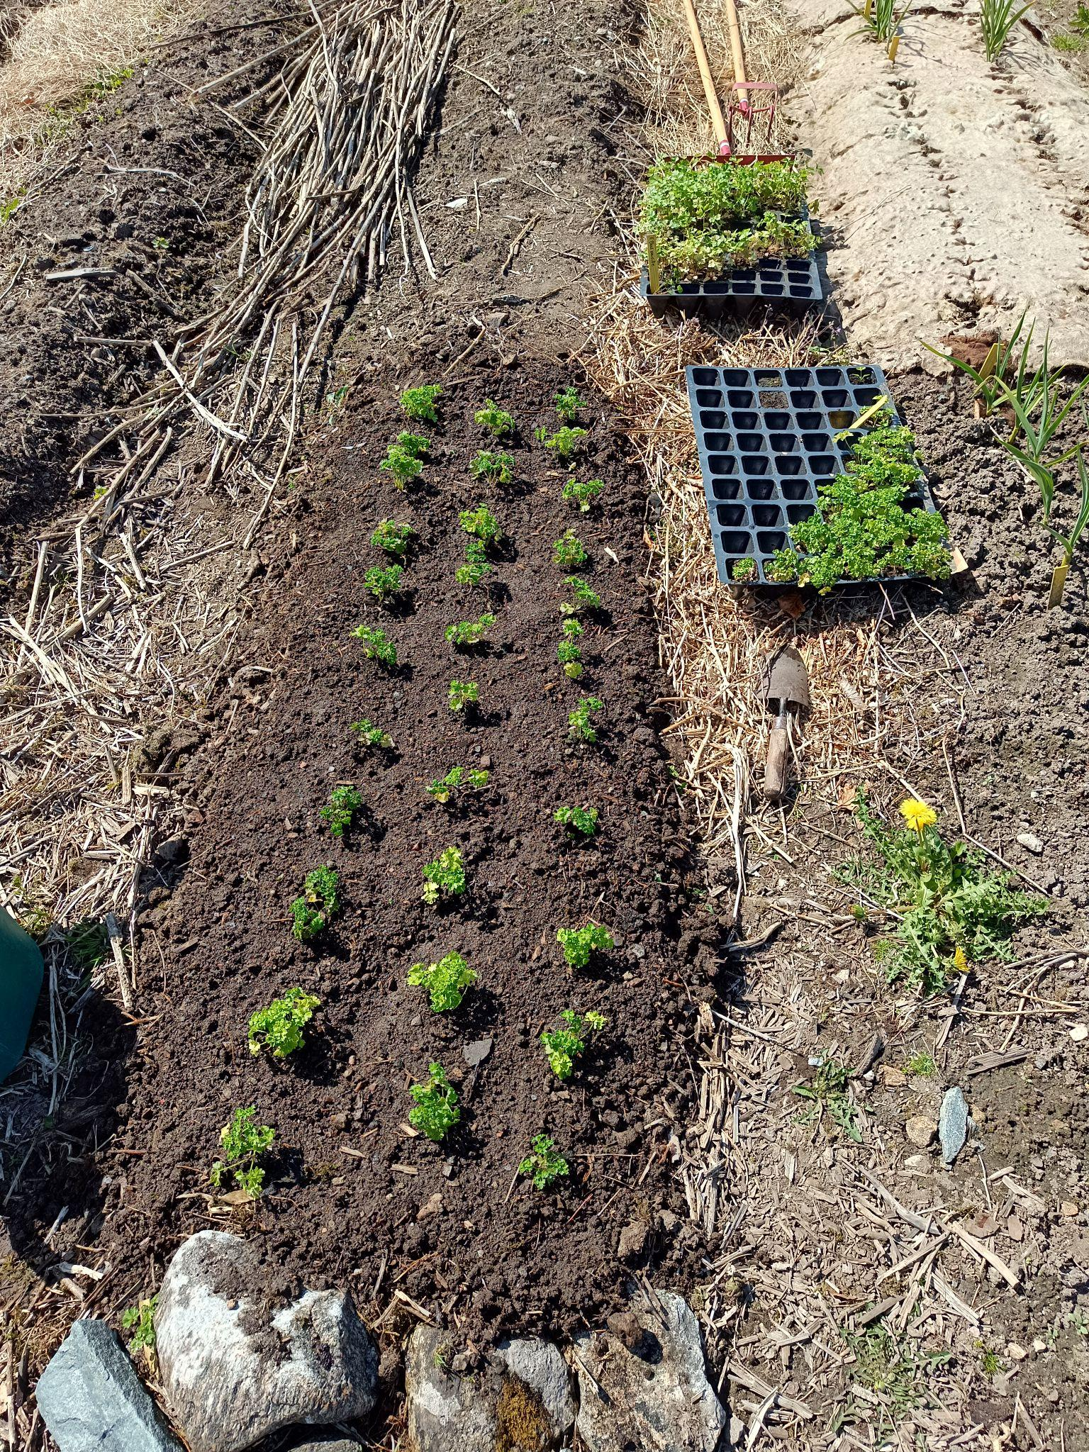
Advisor
to farmers

Slide 2
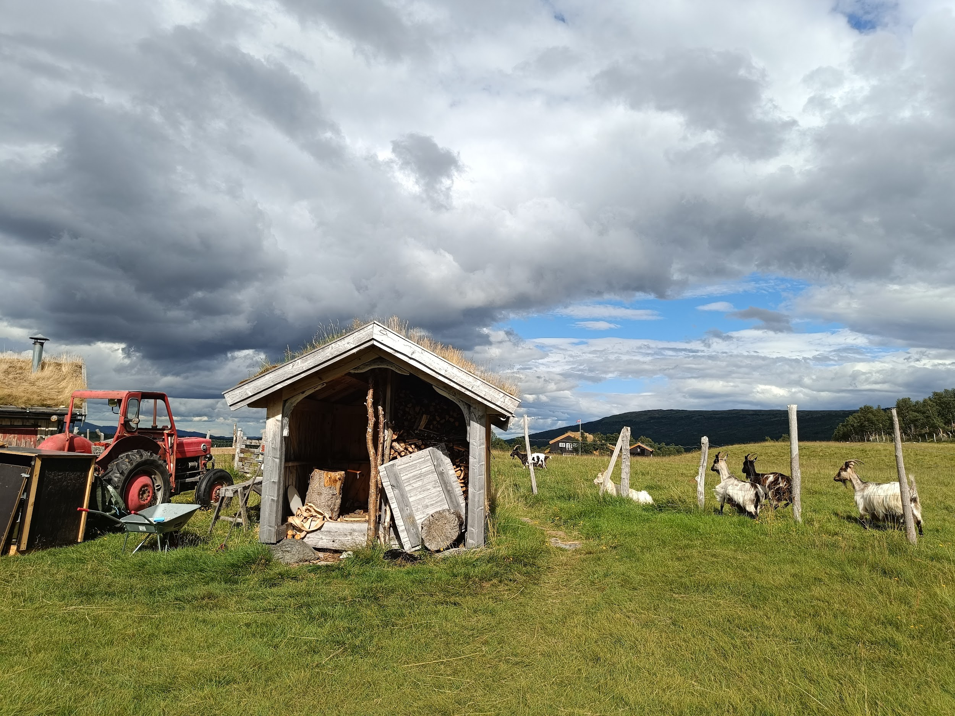
Problem
farmers are busy
mistakes can lead to waste of product, working time or harm to the environment
agriculture advisory is expensive

Slide 3
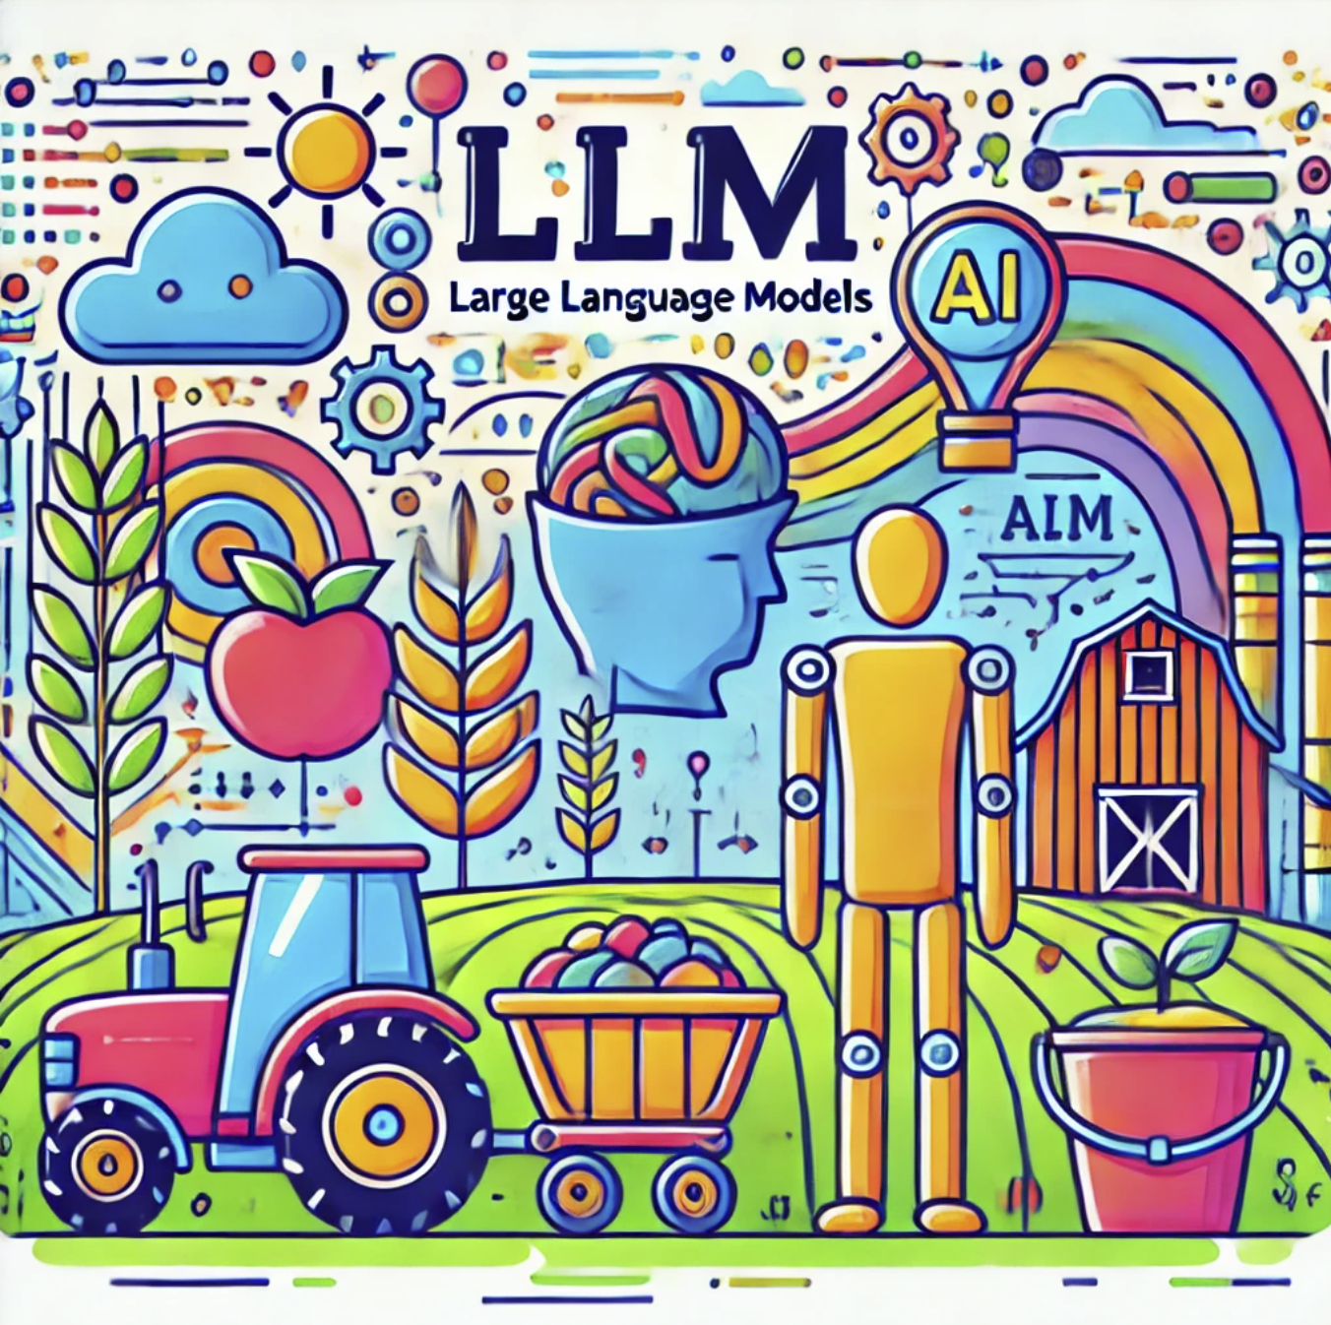
AI-based advisor in the form of a chat dialog
can help utilizing:
recent research
farmer’s values
local nuances
traditions
technological advancements
* The image is from the article
“Embracing Generative AI in Agriculture”

Slide 4
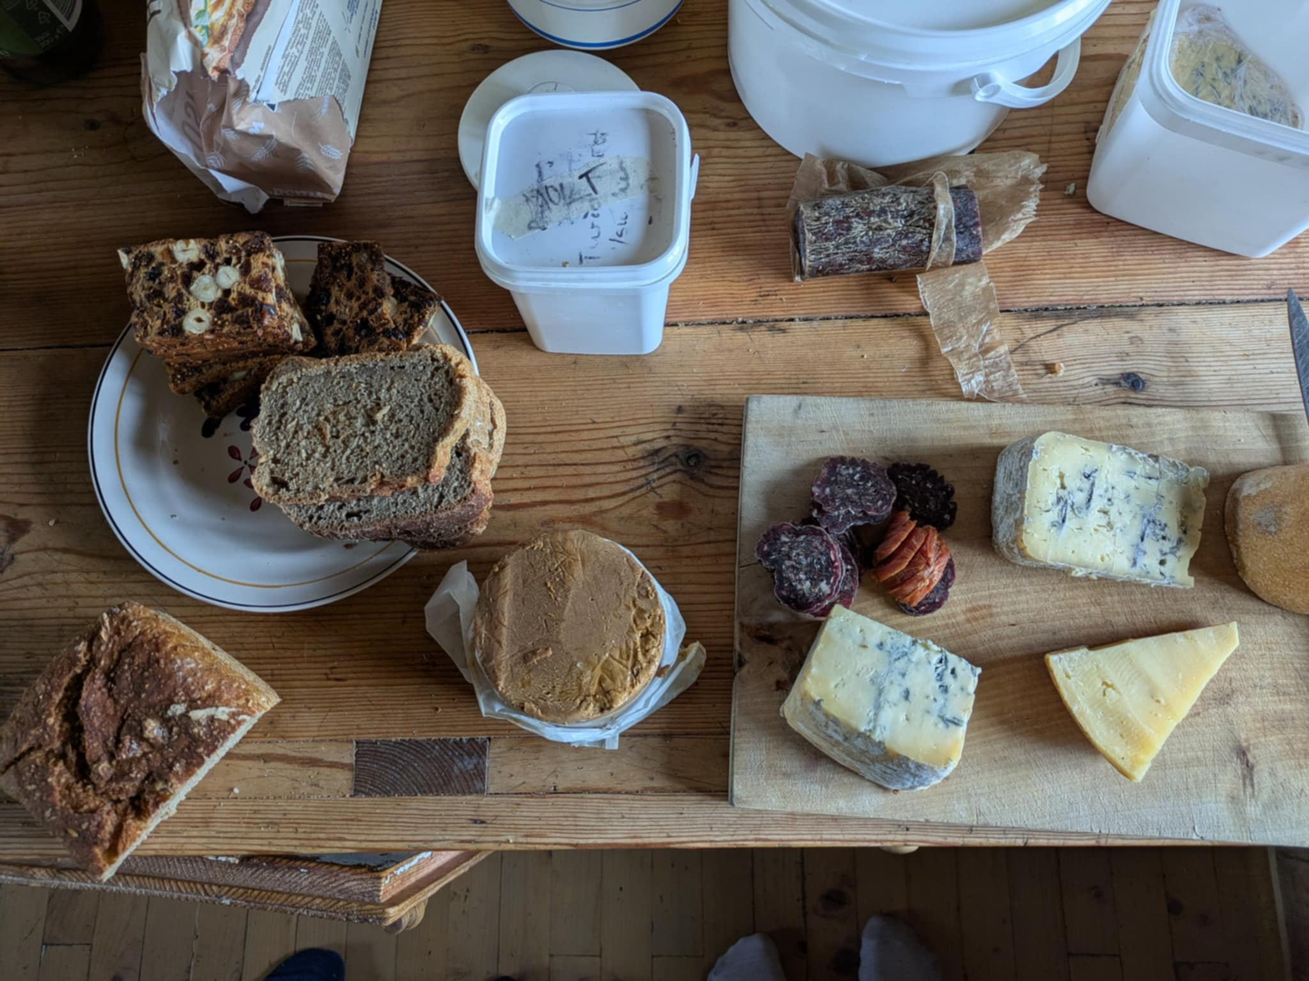
Benefits
that potentially lead to
knowledge based decisions
cost and resource optimization
easy to interact
higher quality products
increase of local food production
better environment
more food

Slide 5
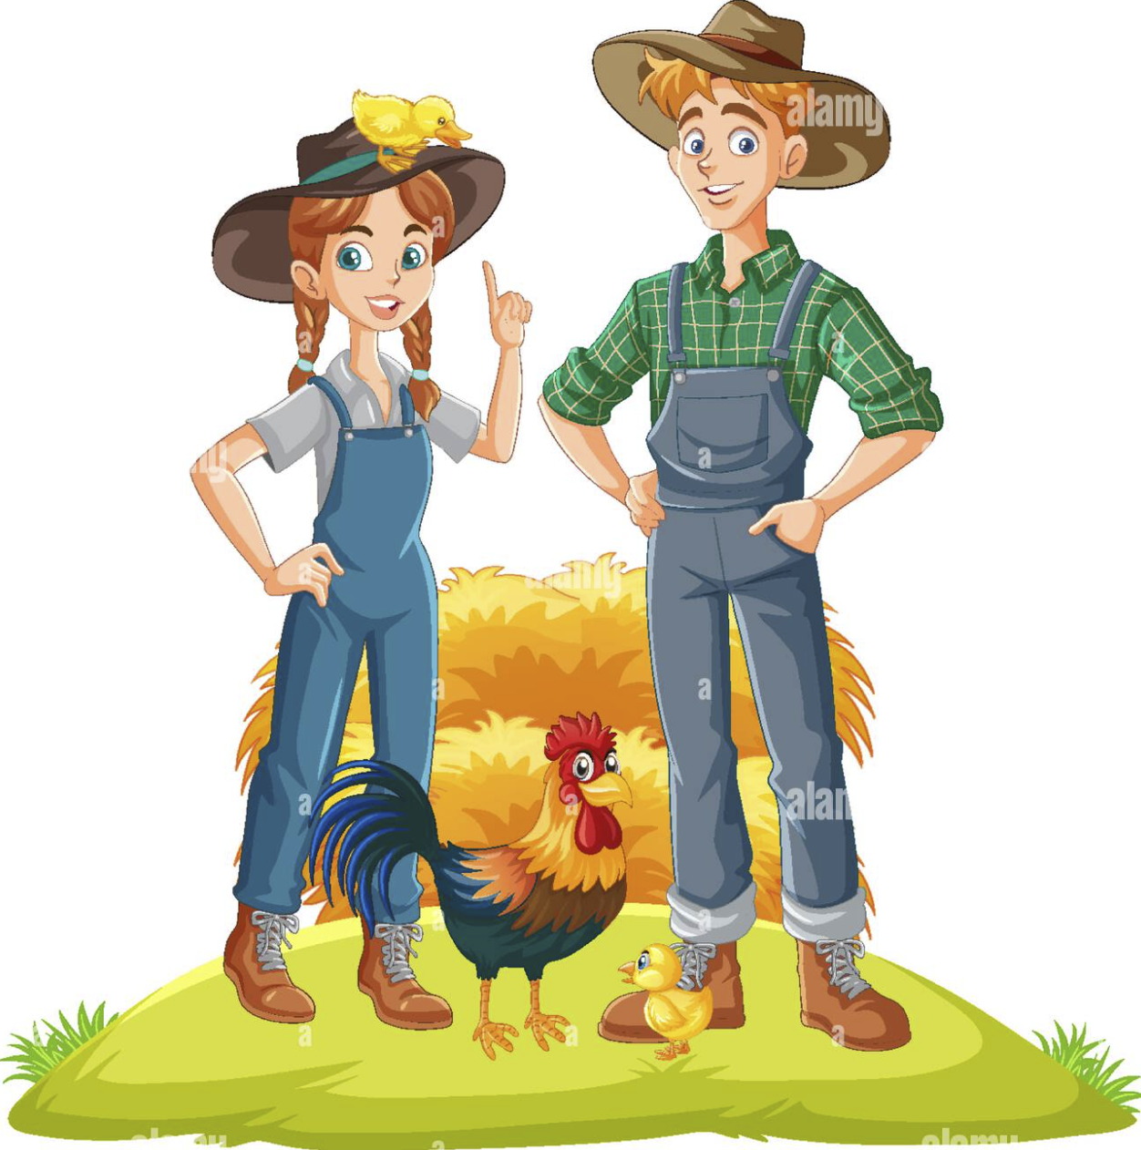

Farmers say
We are from Sweden and we bought a farm in Møre og Romsdal.
What should we know about the local conditions?
I want to start making cheese. I have studied from books, but I still have questions.

Slide 6
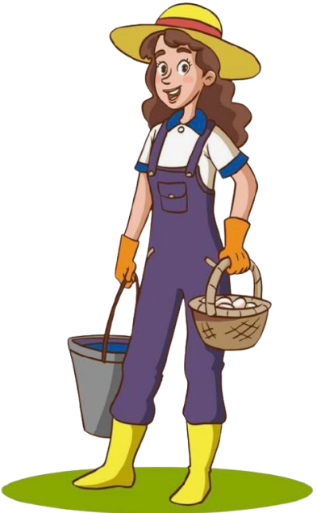

If farmers don’t find the right solution for their problem
they might look what their neighbors do or make mistakes:
I had to throw away hay for horses because it got moldy
If searching for the right advice takes more than 15 mins I give up

Slide 7
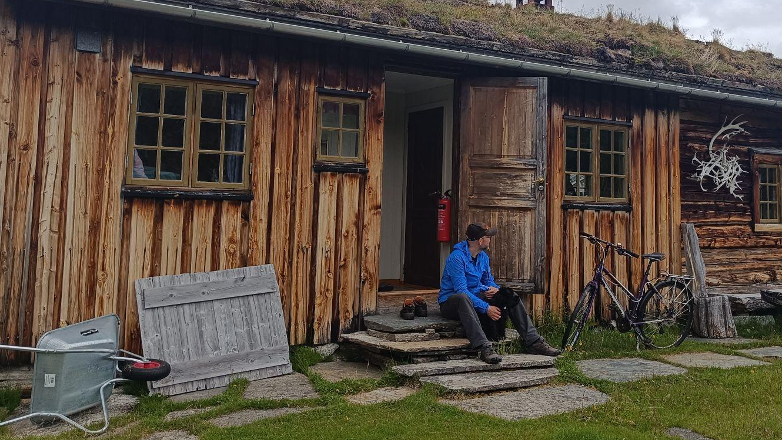
Agriculture in Norway
Topography, geology, and biology form the foundation for plant production, while climate and geography determine the types of crops that can be grown in specific areas.
"Norway has a marginal production area for many important crops and is one of the few European countries that cannot grow sugar".
When discussing Norwegian agriculture, it is important to consider the country’s northern location. Some parts of Norway are in the Arctic, which makes agriculture a challenging endeavour.
"Due to Norway’s climate, grain yields per hectare are lower than in most other European countries. In many parts of the country, growing fodder crops, mainly grass, is the only viable option."
One of the advantages of the cool climate is that it helps limit the spread of plant diseases and pests. These climatic and geographical conditions shape Norwegian agriculture. Soil, latitude, and climate are all interconnected
see more

Slide 8
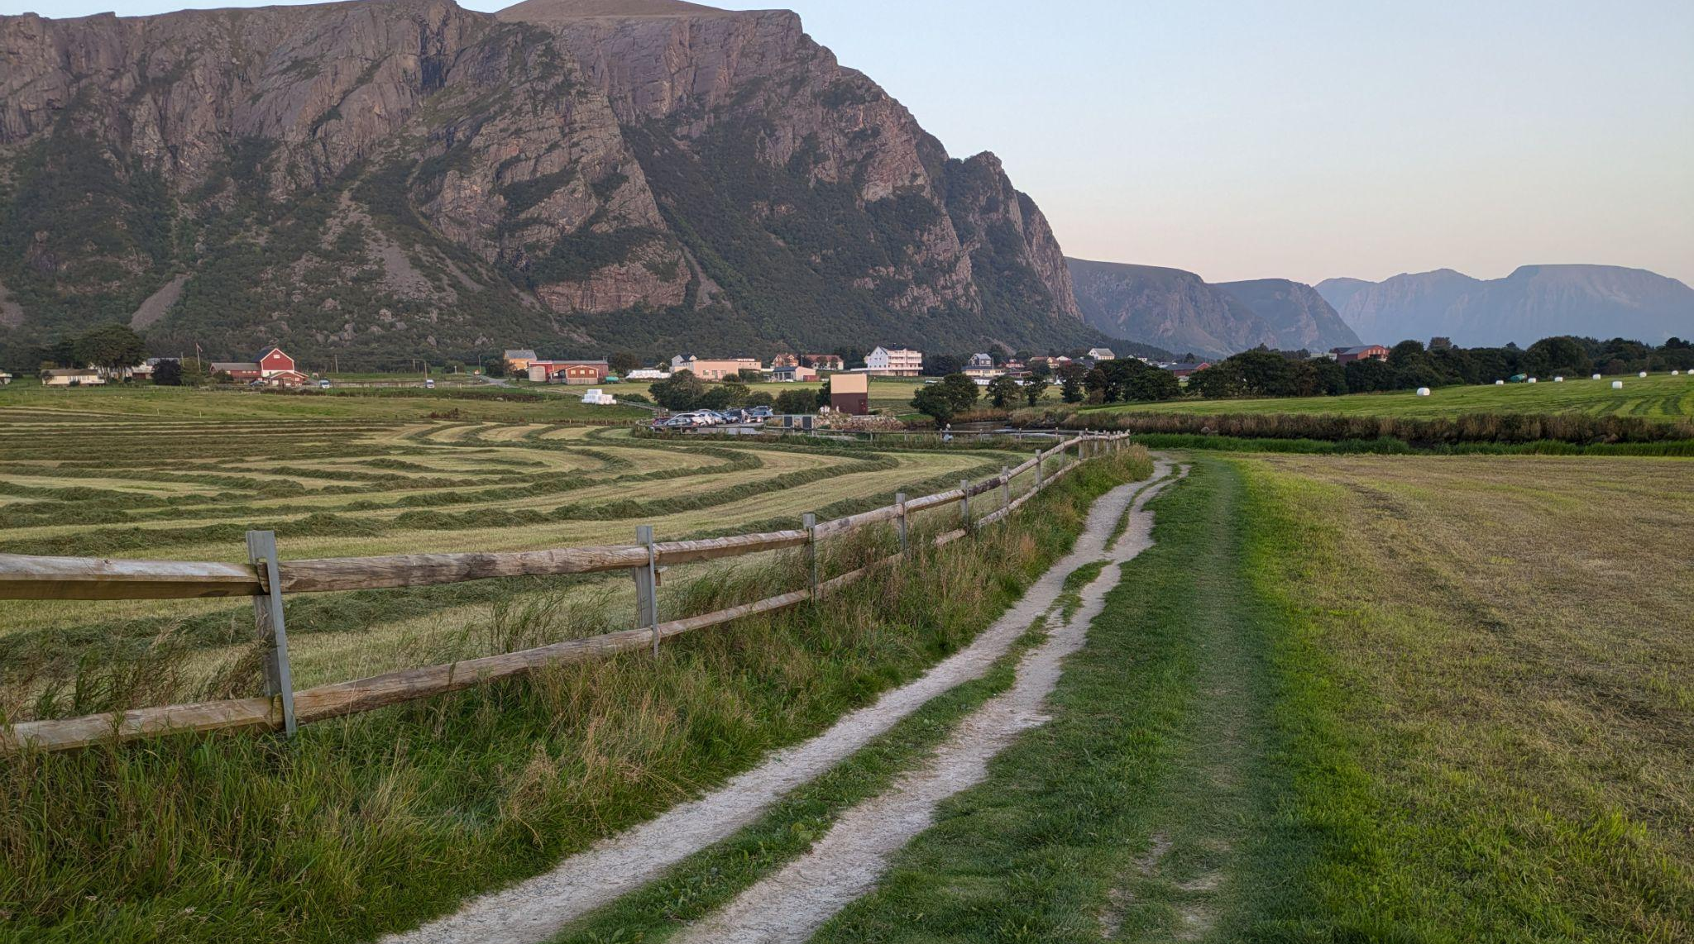
Agriculture in Norway
Grass-based livestock production is the backbone of Norwegian agriculture.
A significant portion of the country’s home-grown grain is used as fodder due to crop quality.

Slide 9
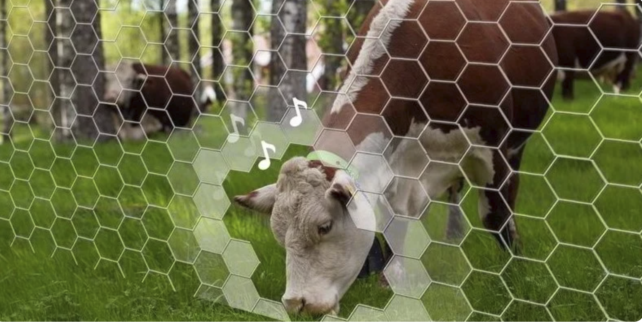
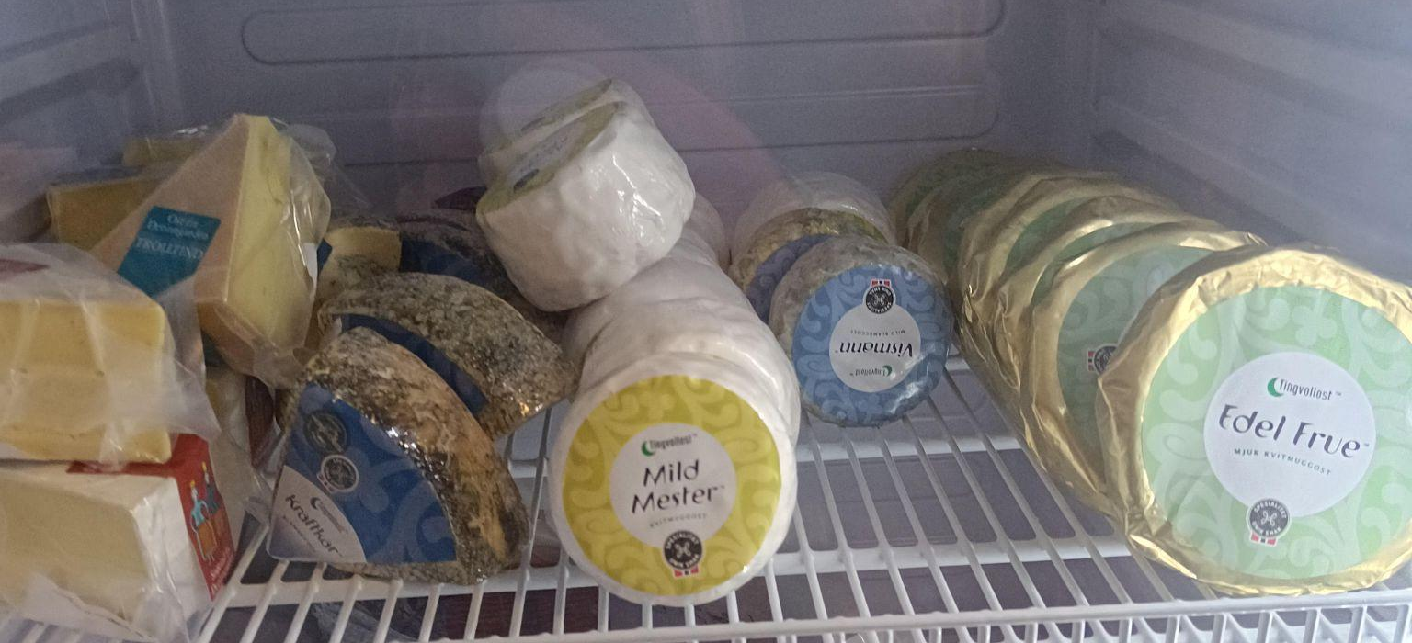
Fact about agriculture, see more
Virtual fencing, see more
Norway's agricultural landscape is undergoing a remarkable transformation. While milk consumption has halved over the past three decades, cheese and poultry have surged in popularity. Today, the average Norwegian consumes 19 kg of cheese and 20 kg of poultry annually - a staggering increase of 5 kg and 14 kg respectively since 1995
Farmers need to follow regulations, changing market requirements and opportunities of new technologies.

Slide 10
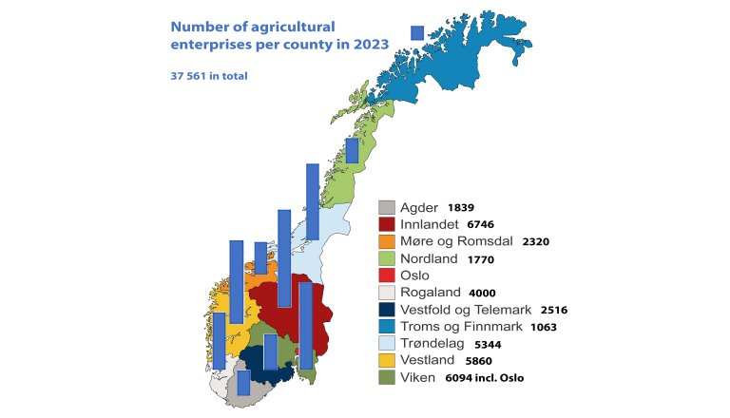
Estimates
* The image is from the article
“How much do Norwegian farmers earn?” of the NIBIO website

Slide 11
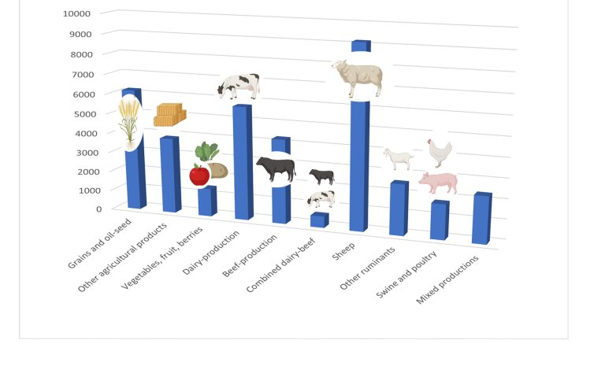
Number of agricultural enterprises per production
Fact
Consumption of meat has doubled in 40 years
* The image is from the article
“How much do Norwegian farmers earn?” of the NIBIO website

Slide 12
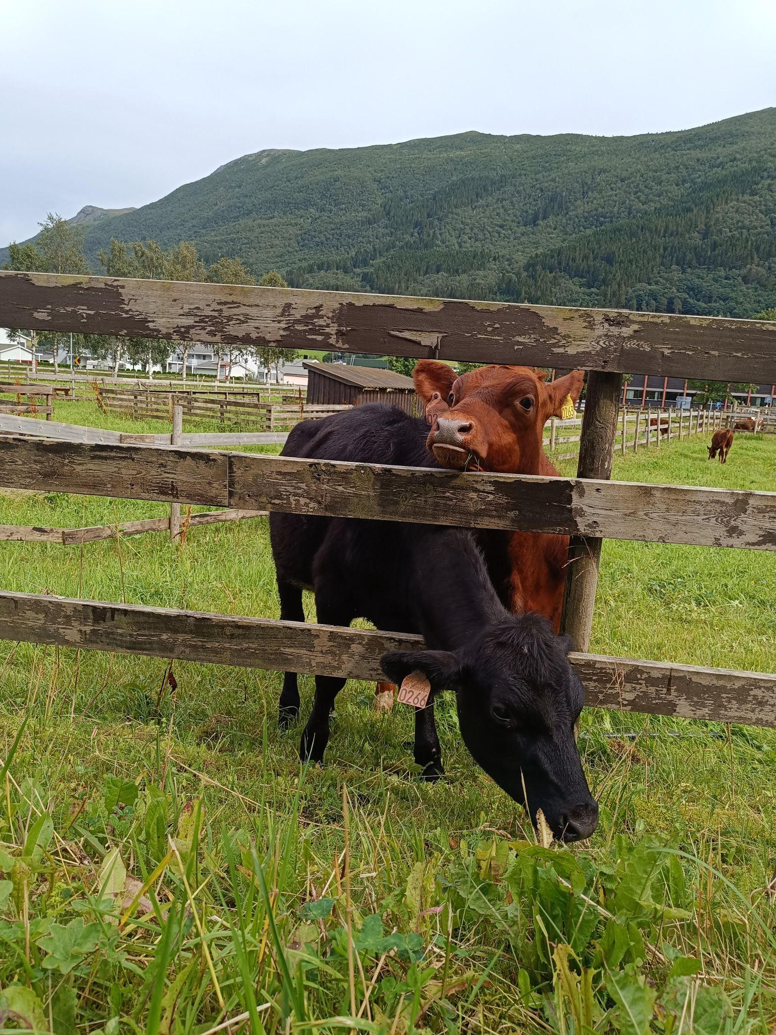
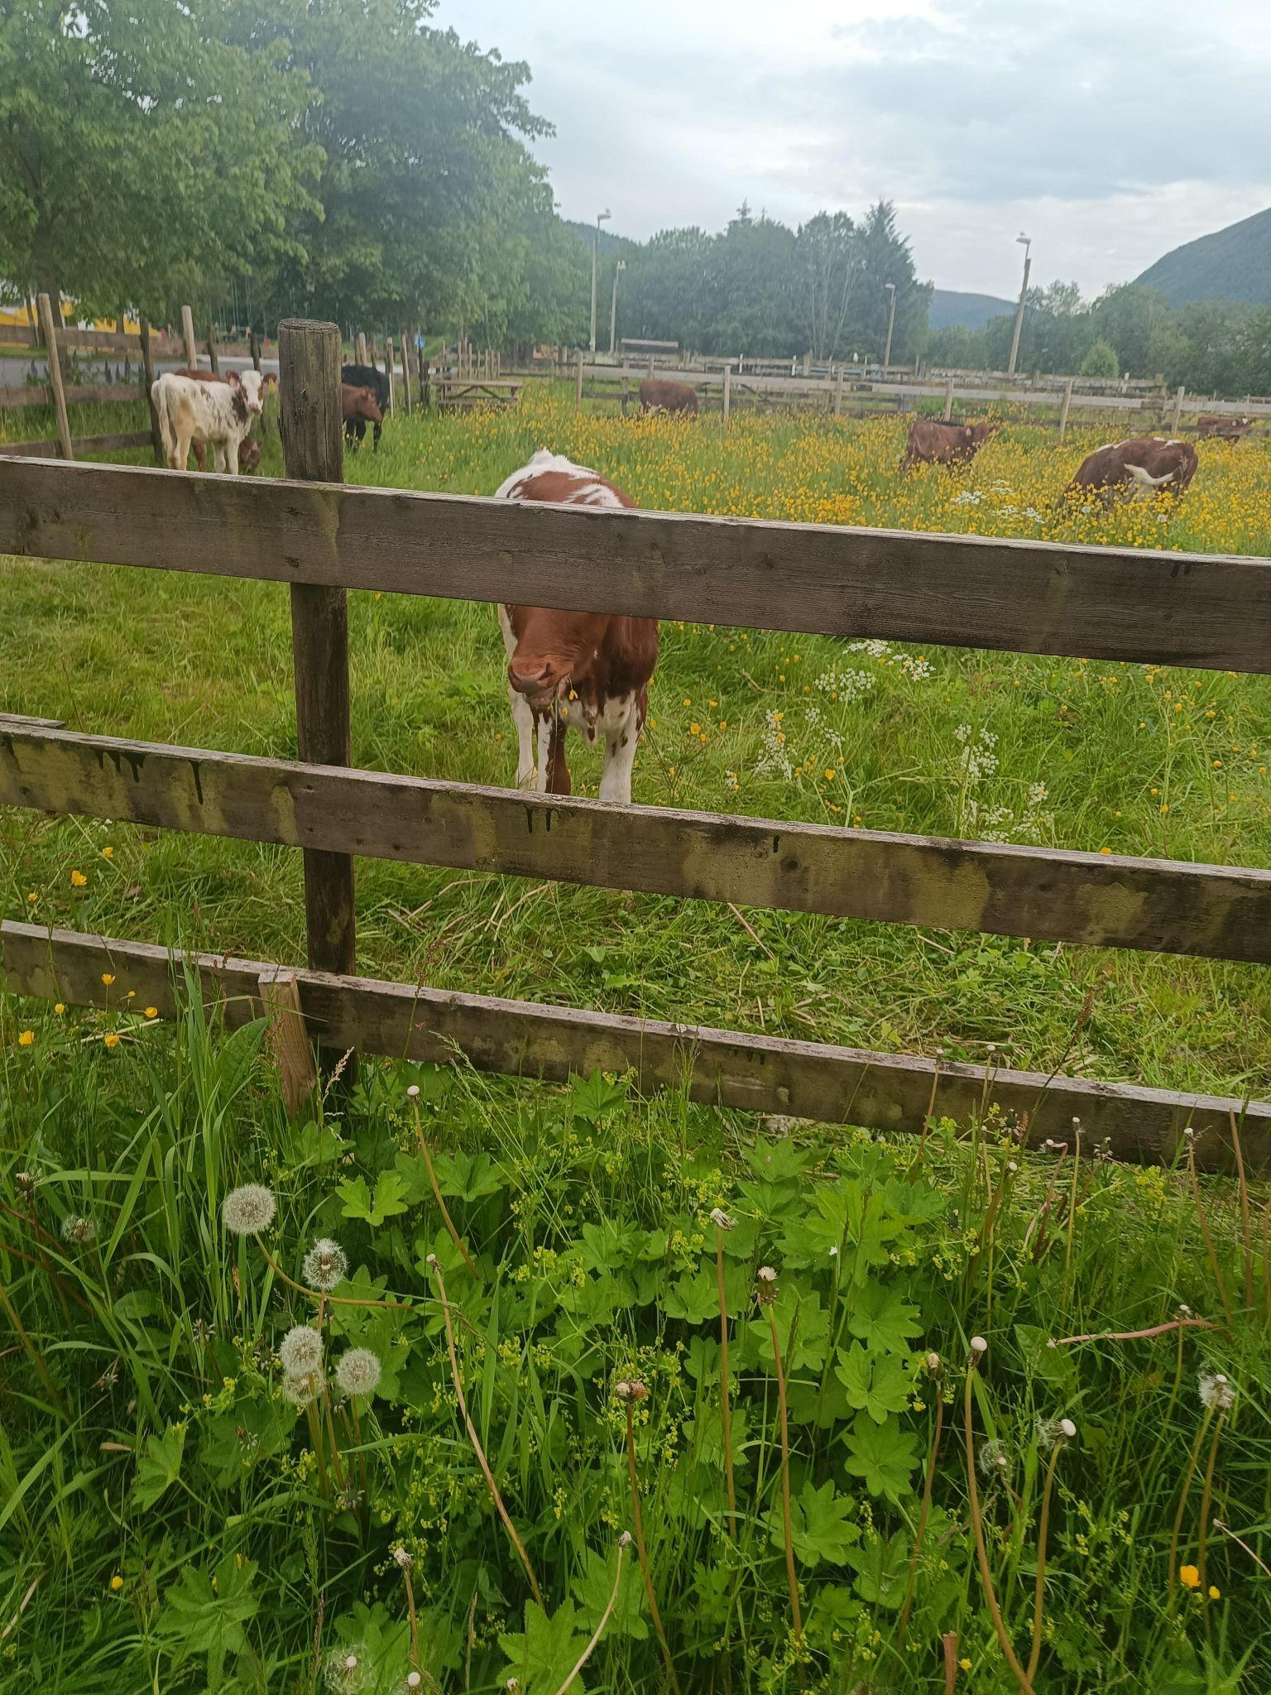
Vision
LLM have succeeded across domains while not being yet enough explored in agriculture.
LLM-based approach is conceptually new and the research can contribute to general knowledge.

Slide 13
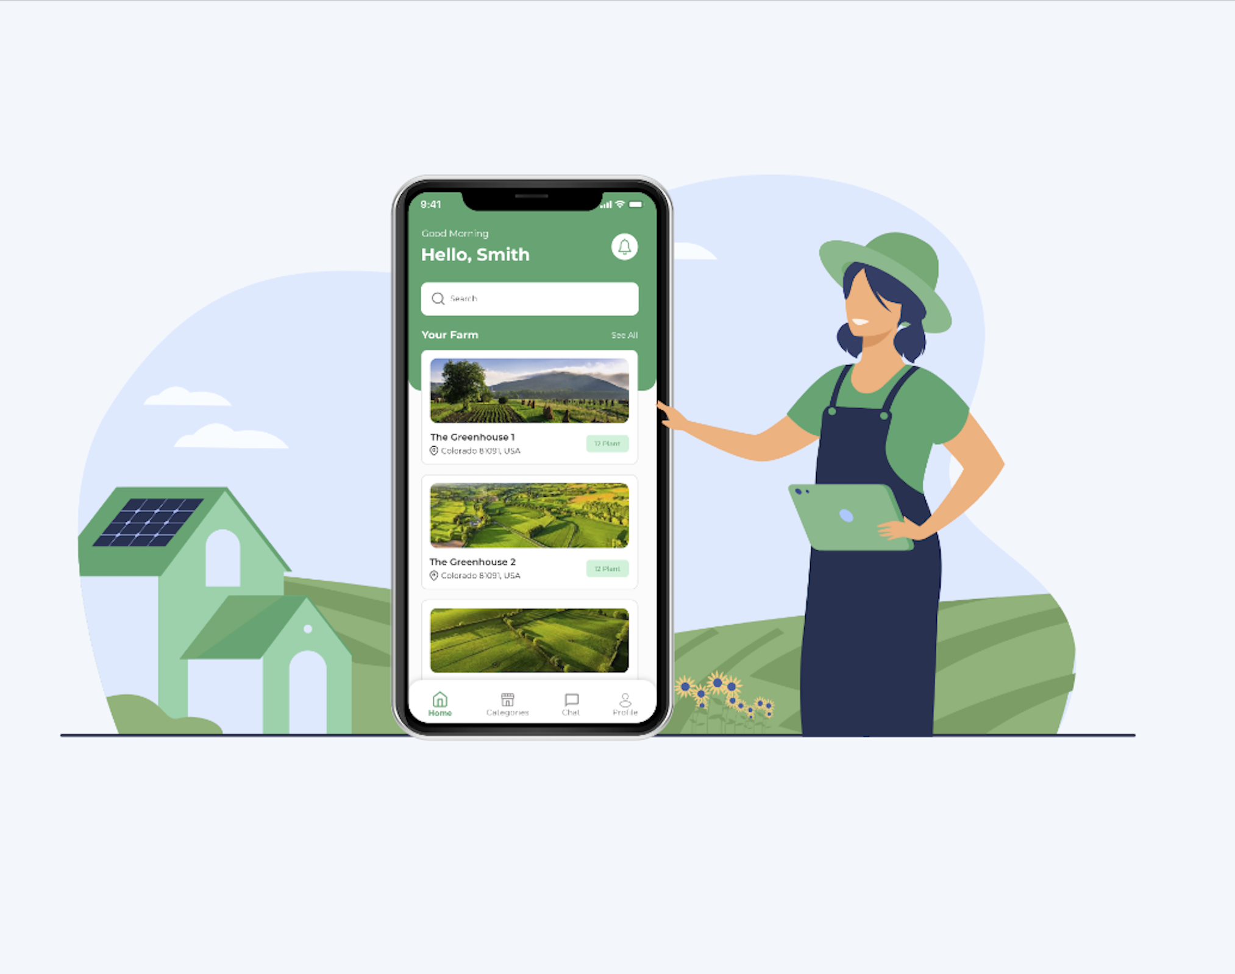
End Users
Can have a chat dialog in their mobile app or on a website related to agriculture.
The service can be non profit or with possibilities of monetisation such as paid subscription or advertisement

Slide 14
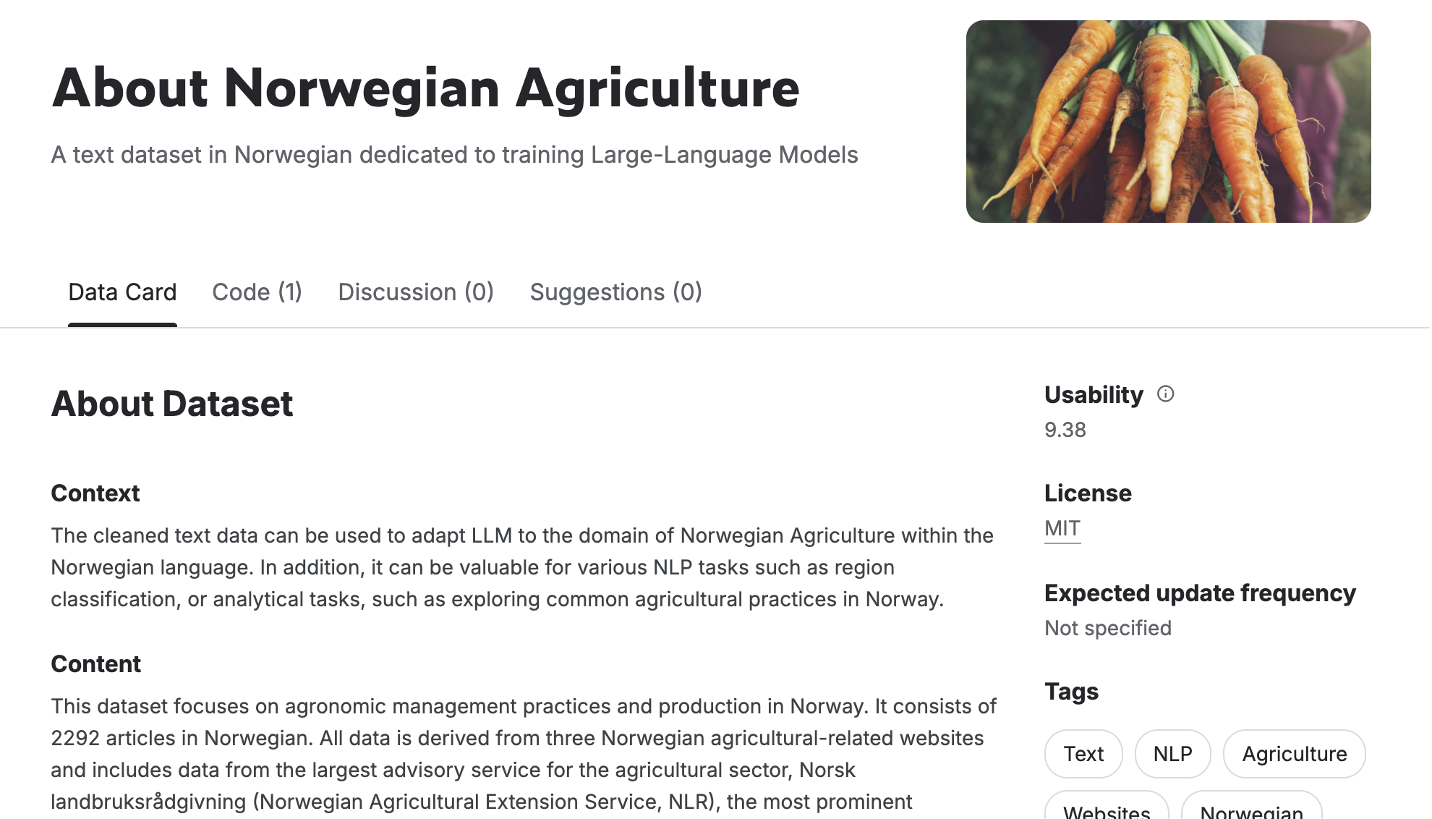
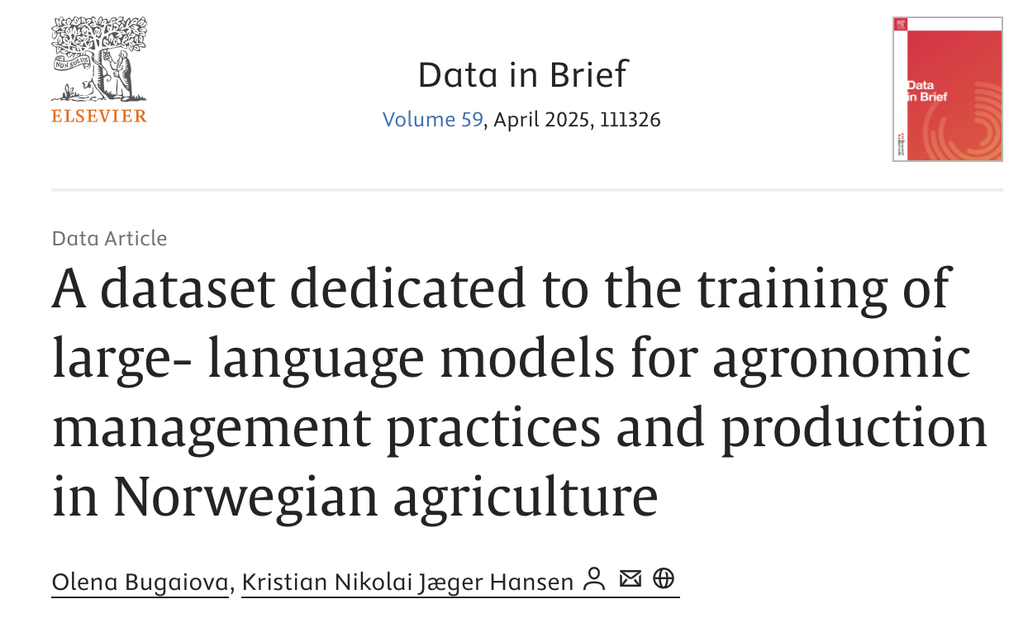
Previous work
Collected text data and shared on Kaggle
Described web scraping of the data by providing notebooks with code
Created a Kaggle notebook demonstrating RAG for Question-Answering on our data
Published a research paper with Kristian Nikolai Jæger Hansen: “A dataset dedicated to the training of large- language models for agronomic management practices and production in Norwegian agriculture”

Slide 15
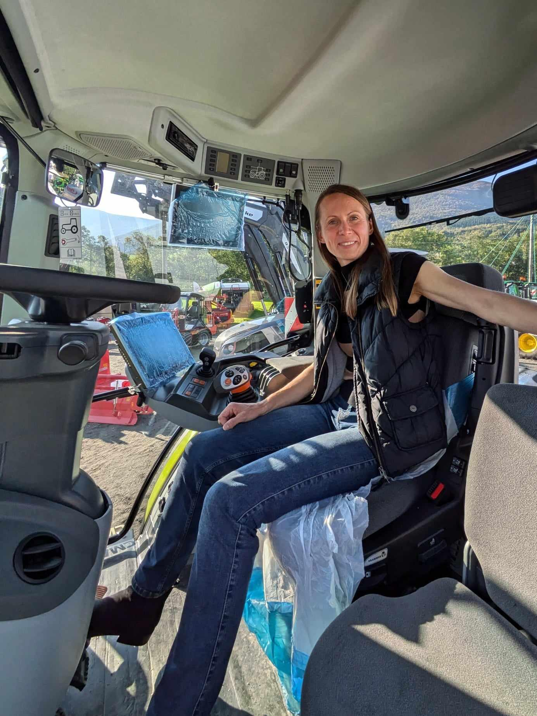
About me, Olena Bugaiova
Work Experience: • Data Scientist at Norwegian Institute of Bioeconomy Research (NIBIO); • Data Scientist at Deep Knowledge Analytics; • Machine Learning Engineer at Omdena, Nestre; • 5+ years of experience in Java Development for clients like AT&T, Liverpool and Manchester; • 2+ years of experience in Game Development, created my version of sudoku scored 12k views
Norwegian Language Practice: Norwegian Center for Organic Agriculture (Norsøk), B1
Projects: • innmarksbeite image classification with Chat GPT multimodal model; • biological age prediction; • recommender system for mental health trainings
Education: • MS and BS in Applied Mathematics from Kharkiv National University in Ukraine; • MS and BS in Economics and Enterprise from Kharkiv National University in Ukraine
Courses: • Machine Learning Foundations from University of Toronto and Vector Institute; • MITx MicroMasters program in Statistics and Data Science with 4 courses and capstone exams; • Deep Learning Specialization with 5 courses on coursera
Grants: Cohere Labs Research Grant

Slide 16
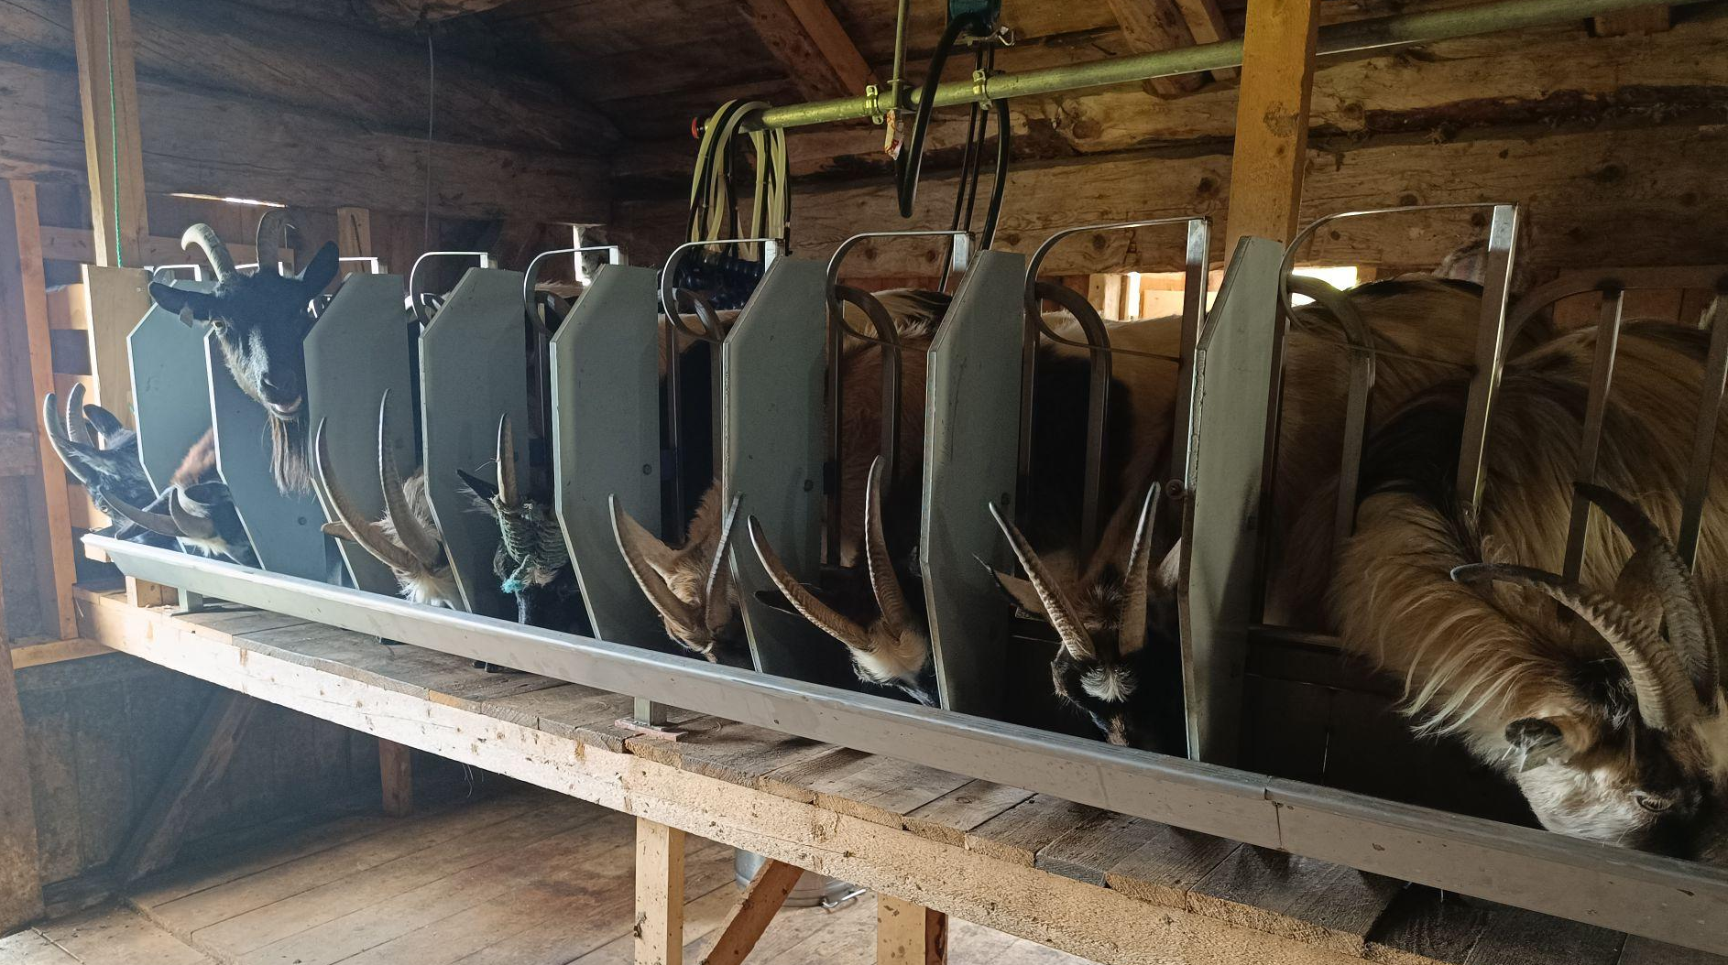
Thank you!

